Slide 1
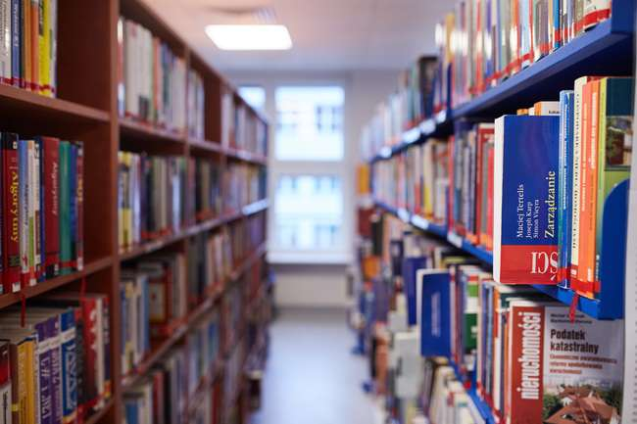
The Library of WSB University in Gdansk and Gdynia
Your place in the University

Slide 2
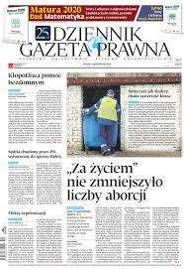
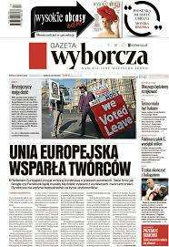
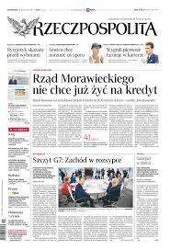
Our resources
Traditional book collections
Browse>
57 000 available items at the library in Gdansk and Gdynia
e-sources
Browse >
thousands of e-books and full-text journal databases
Trade journals
available in the reading room, including electronic editions, among others:
Virtual reading room Academica
Browse >
over 3 000 000 files provided by the National Library

Slide 3
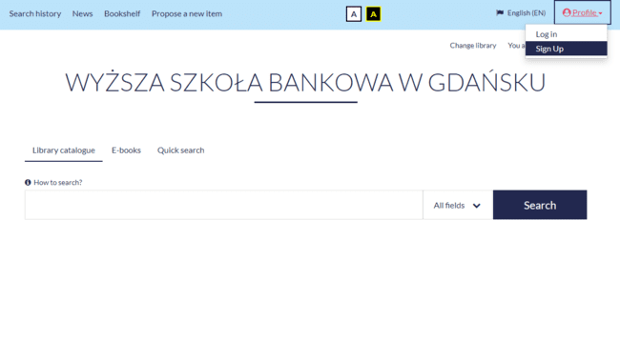
Become our reader
Fill out the registration form on the library catalog website. Select the Account tab and https://biblioteka.wsb.gda.pl/integro/catalog
If you are our student in the section ’’ID type” choose ’’Legitymacja studencka” and in section ”ID number” write number from your student card ”numer albumu”.
Activate an account in the Library (by e-mail, by phone or in person) within 21 days from filling in the form. Otherwise, the account will be automatically deleted.
Sign up >

Slide 4
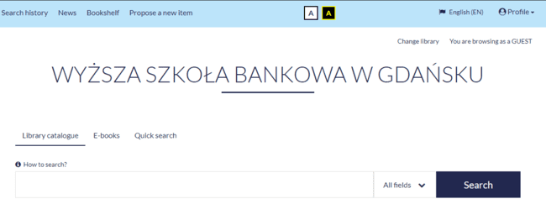
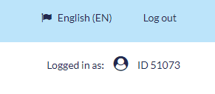
Browser Integro
The Integro catalogue allows you to browse books and journals resources, whereas after logging in and clicking on the ID number you gain access to additional functionalities:
requesting a book before visiting the Library - you gain time and certainty that they will be available,
booking an item that is currently on loan - after return it will go straight to you,
extending the deadline for returning books - conveniently and at any time,
checking the search history of your account - you have got everything under control!
Search by indexes:
→ by title, author → by keywords
by document type:
→ e.g. book, article
quick search – e.g. by file no.

Slide 5
First login
During the first visit to the library, when activating the library account, you will receive a login ID:
→ if you are a student: gd or ga+ student ID number (e.g. gd123456)
→ if you are a postgraduate or MBA course participant:
Gdansk: gd + underscore + the first letter of the first name and surname (e.g. gd_mkowalski)
Gdynia: the first three letters of the first name and surname
Alternatively, you can use the ID assigned to your account during registration.
Password
Take care of the security of your account, we recommend that the password consists of at least eight characters:
→ upper and lower case letters
→ digits
If you enter an incorrect password three times when trying to log in, your account will be blocked and a link to unblock the account will be sent to the e-mail address provided during registration.

Slide 6
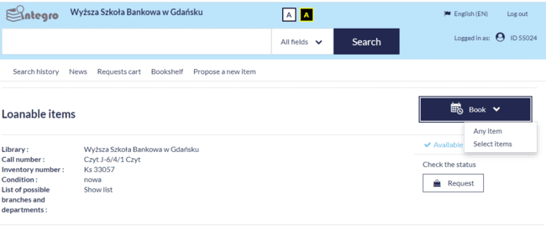
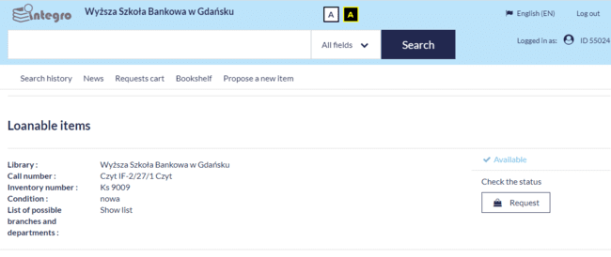
Requesting and booking
Log in to your Library account >
choose a book you are interested in
click REQUEST
the book will be waiting 7 days for collecting
If the selected item is on loan, you can book it
click book and any item, and then confirm
after returning to the library, the book will be waiting for collection for 7 days
the booker will be informed by e-mail about the waiting book

Slide 7
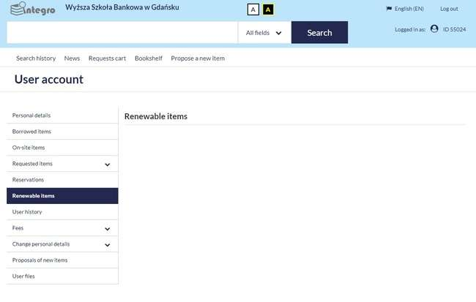
Circulation desk
Borrowing limits:
6 books – Bachelor degree, Master degree, postgraduate, MBA, doctoral studies
Borrowing period: 4 weeks with the possibility of prolonging the return date,
unless the book has been reserved by another Reader!
Short-term access to the most valuable items
→ the date of return is agreed individually
Renew books:
→ independently - after logging into the Integro catalogue
→ by submitting a request to us by phone, e-mail or in person

Slide 8
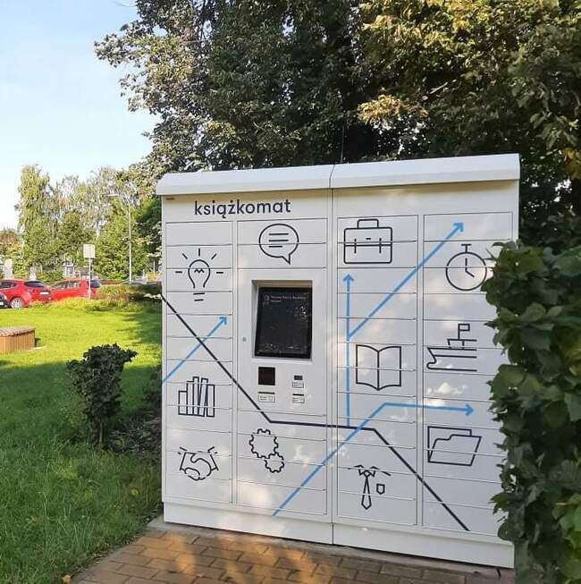
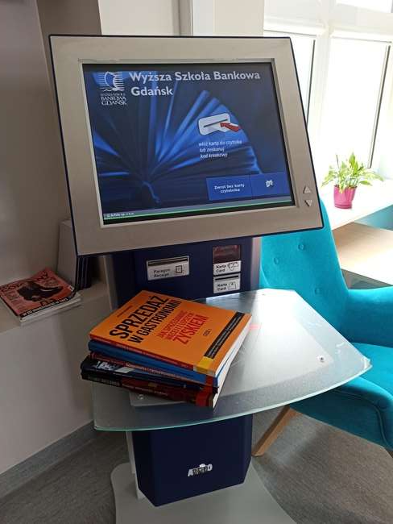
Book machine and selfcheck
You can order our books through catalogue:
In the section ”Choose an access location” mark Książkomat
When books will be ready to collect you receive a confirmation by e-mail
You can collect your order in 7 days since you received a confirmation e-mail
You can read more information on our website:
https://www.wsb.pl/gdansk/strefa-studenta/biblioteka
You can borrow books yourself using the selfcheck. It is located in the reading room. You need to insert the card into appropriate slot, place the books in the designated place and follow the messages displayed on the touch screen. On the selfcheck you can also check how many books you currently have on your account.

Slide 9
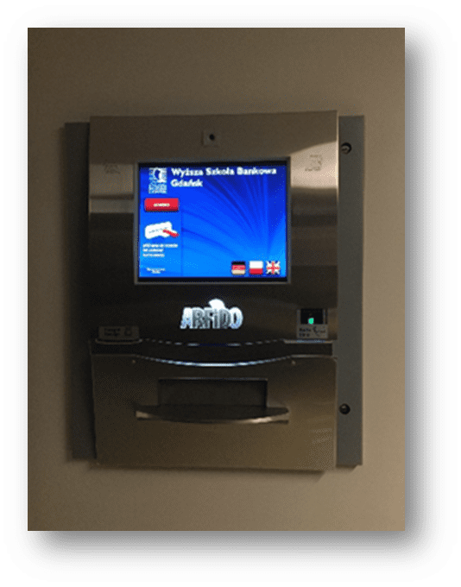
Returning books
Thanks to the drop box, there is no need to stand in a queue. You can return books regardless of the library's working hours.
You can return books from your account yourself using the automatic depository
Returning books:
• place the card in the reader with the chip facing up or read the library card in the barcode reader above,
if you do not have your ID with you, select the OPEN option on the screen.
Insert books one at a time, making sure that the drop box has accepted a given copy.
Familiarize yourself with the rules of using the automatic depository on our website.

Slide 10
Support animal shelters
Fee for books overdue = PLN 1 per day for each item
By settling the fees for keeping books, you can support one of the Tri-City shelters:
OTOZ Animals Homeless animal shelter Ciapkowo in Gdynia 50 1440 1026 0000 0000 0452 8344
Homeless animal shelter Sopotkowo in Sopot 80 1020 1853 0000 9102 00 10 14 85
Promyk Shelter in Gdansk
18124012681111001038597629
As part of the settlement with the Library you can purchase the book indicated by us, thus contributing to the expansion of our book collection - its value will be lower than the fee
All you have to do is pay the calculated amount for the selected shelter in the title of the transfer by entering "donation + number of your album" and send us a payment receipt - on this basis we will settle your account.

Slide 11
E-sources
E-books and electronic editions of scientific journals are available 24/7
select the base you are interested in from the list:
logging in via HAN = similarly as to the Integro catalogue: e.g. gd123456 + password

Slide 12
E-sources
IBUK Libra - a wide selection of Polish e-books available in the online reading room.
BIBLIO ebookpoint - online Polish electronic book borrowing spot. After logging in, create an individual account in order to borrow books on the shelf.
Legalis and Lex - databases containing legal acts from individual Journal of Laws of the Republic of Poland, Monitorów Polskich (en. The Polish Monitors) and official journals, as well as jurisprudence of selected courts, official explanations and model letters, templates of letters, as well as comments and e-books.
EBSCO, Emerald Insight, SpringerLink, Wiley Online Library, ScienceDirect, ProQuest ABI/Inform Complete, - multidisciplinary databases containing publications in the field of social, economic, political science and also humanities.
EMIS - economic website with reports on emerging trends.
Scopus and Web of Science - abstract and bibliographic databases of scientific literature.

Slide 13
Reading room
book collection systematized in 40 sections by topic:
A- Administration
B – Banking
BL – Library Science
BW – Internal Security
E – Economics
ET- Business ethics
F– Finance
FM- International finance
FP – Corporate finance
FZ- Philosophy
G- Geography
Gl – Globalization
H - History
HZ- International trade
I – Investments
IŻ – Engineering sciences
IF – Informatics
J – Foreign languages
L – Logistics
M – Mathematical sciences
MR – Marketing
N – Negotiations
PE – Pedagogy
PL- Politics
PLG- Economic policy
PLP- Monetary policy
PM- International law
PR – Law
PS – Psychology
R – Accounting
RZ- Management Accounting
RF- Financial Markets
S- Statictics
SC- Sociology
SZ- Art
T– Tourism
U- Insurance
UE – European Union
Z – Management
ZC – Human health
Open access - you can read each of our books without any restrictions
→ items with a yellow stripe– standard loan (i.a. 4 weeks)
→ items with a white stripe – textbooks for 6 weeks
→ items with a red stripe – short-term loan

Slide 14
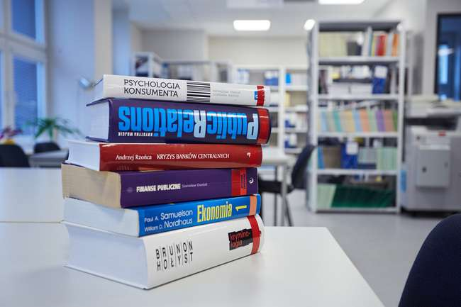
Reading room
We also have collections in English available on-site and for borrowing:
Econ - Economics
Edu - Education
Fin - Finance
Law - Law
Log - Logistics
Man - Management
Mark - Marketing
SocSci - Social Science
Tour - Tourism

Slide 15
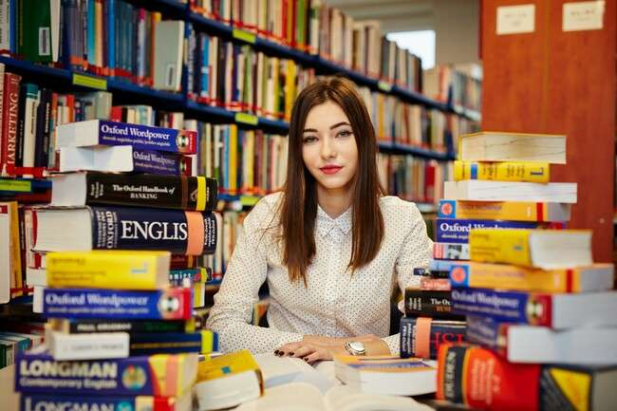
Find a book on the shelf
→ check the book’s file no. in the Integro catalogue
e.g. Wyp¹ BW²-12³/10⁴/2⁵
¹Shelving location :
Wyp – wypożyczalnia (circulation desk)
Czyt – czytelnia (reading room)
Mag – magazyn (stockroom)
²Department indication,
e.g. BW = Internal security
³Subdepartment indication,
e.g. BW-12 = Ecological security
⁴The order of the title on the shelf
⁵Item order of a particular title
… in case of any difficulties, ask a librarian for help, we are here for you ☺

Slide 16
Virtual Reading Room Academica
…The National Library in your Reading Room!
Academica is an innovative tool that enables access to digital resources, including contemporary books and scientific journals from all fields of knowledge collected by the National Library.
Among others :
→ academic textbooks
→ scientific studies
→ selected scientific journals from the list of Ministry of Science and Higher Education System.
Currently, the resources include approximately 3,000,000 and are constantly being expanded.

Slide 17
Build your book collection with us
We encourage you to send proposals to buy new items:
by filling in the Propose a new item form in the Integro catalogue
via email :
biblioteka@wsb.gda.pl or
biblioteka@wsb.gdynia.pl

